Slide 1


Java with Raspberry Pi
Stephen Chin (@steveonjava)
Java Technology Evangelist
JavaOne Conference Chair
James Weaver (@javafxpert)
Java Technology Evangelist

Slide 2
Java Scale
Raspberry Pi Coffee

Slide 3
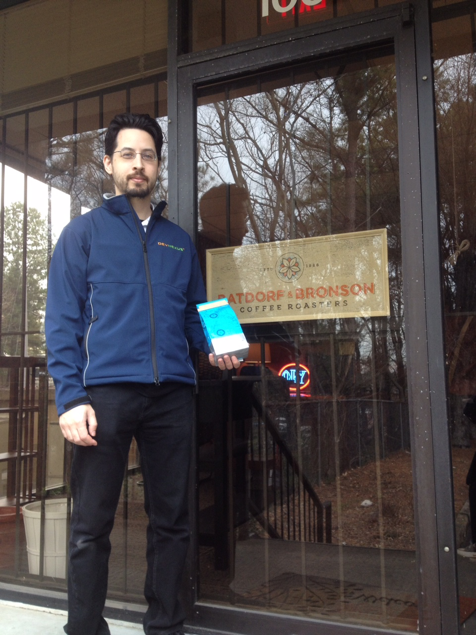

Slide 4
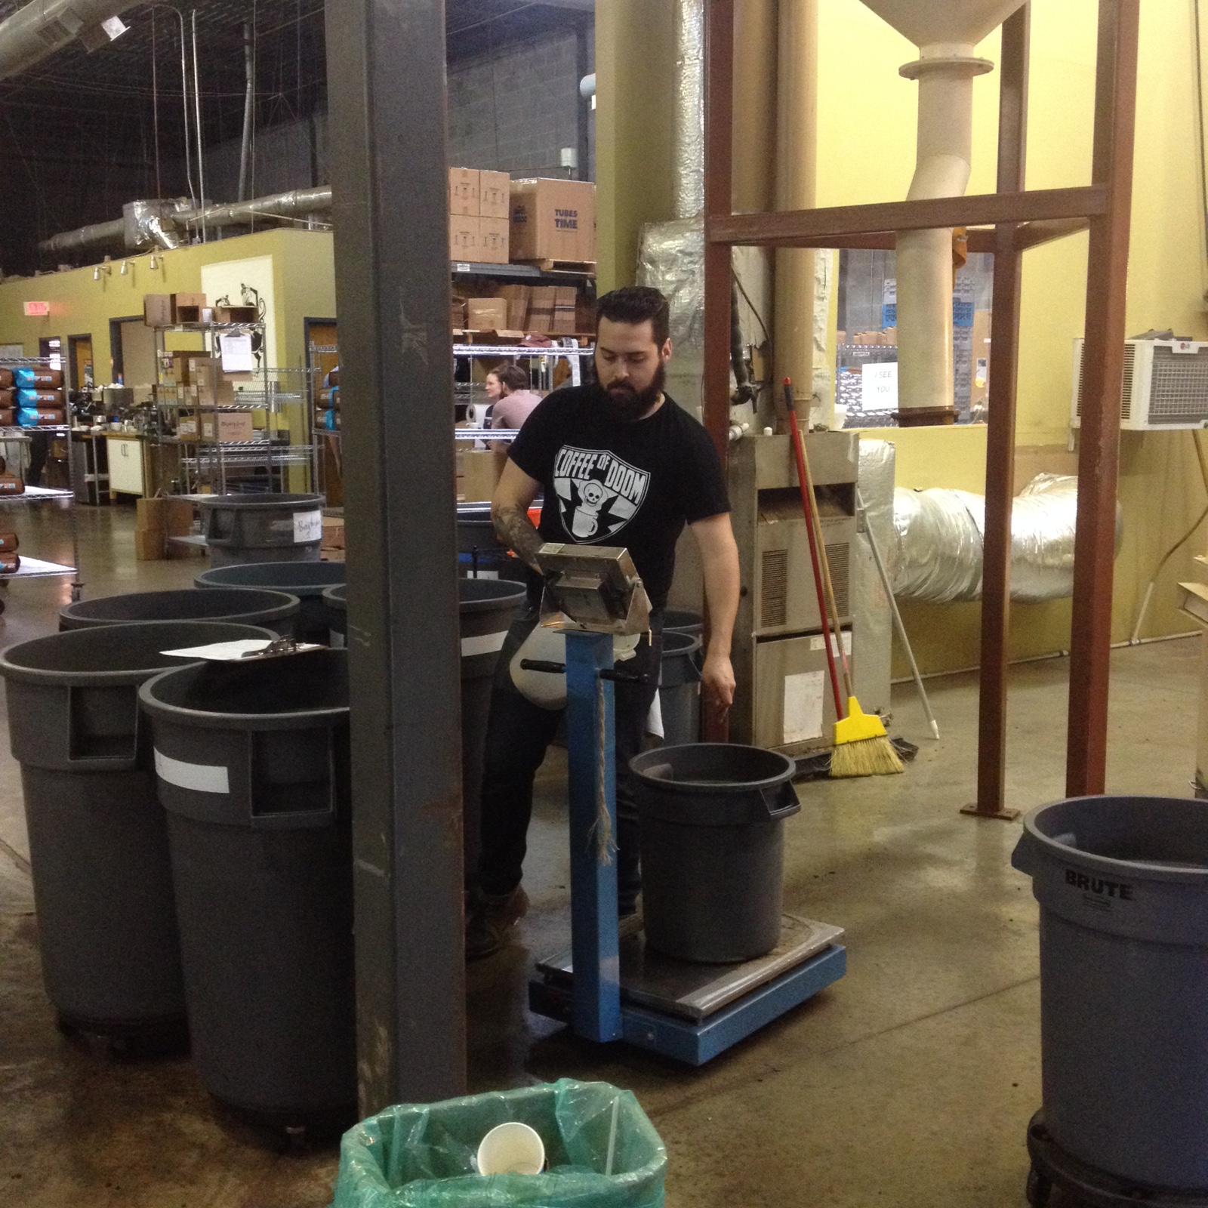
Java Scale

Slide 5
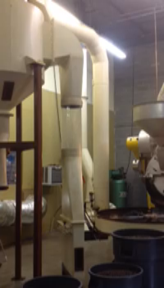

Slide 6
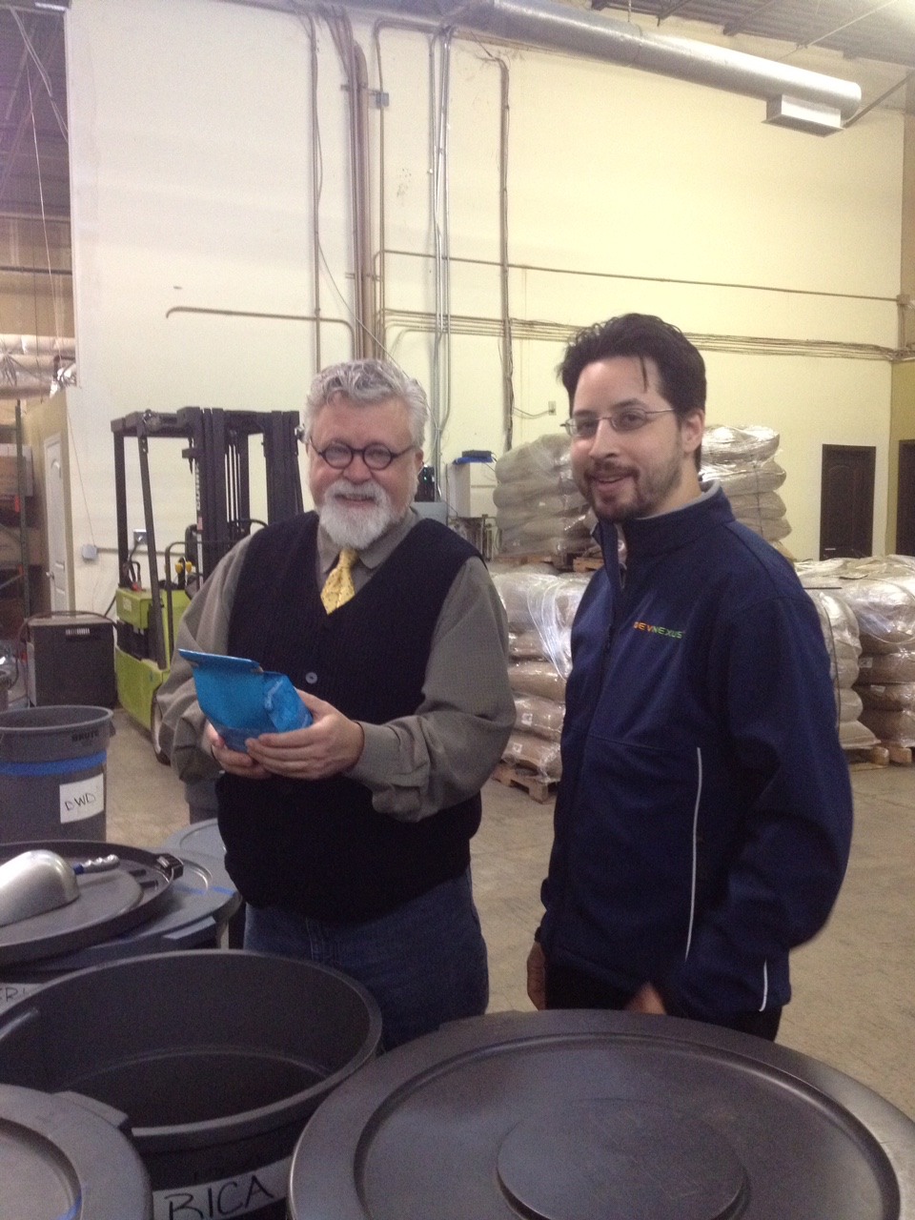

Slide 7
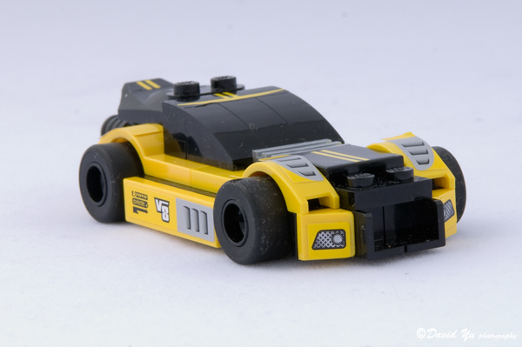
Driving Test
https://www.flickr.com/photos/davidyuweb/1352312273

Slide 8


Slide 9
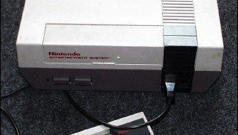

Slide 10


Slide 11
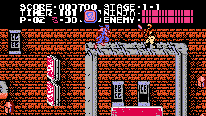

Slide 12


Slide 13


Slide 14
Up-Up-Down-Down-Left-Right-Left-Right B, A, Start

Slide 15
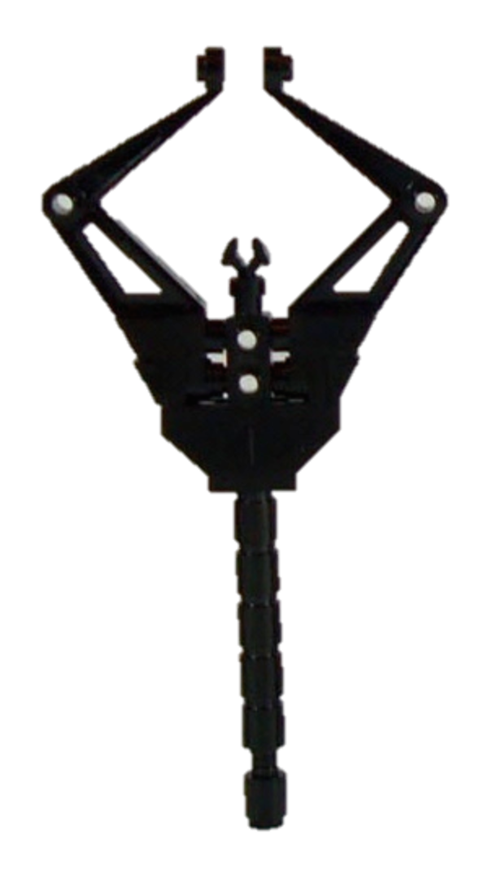
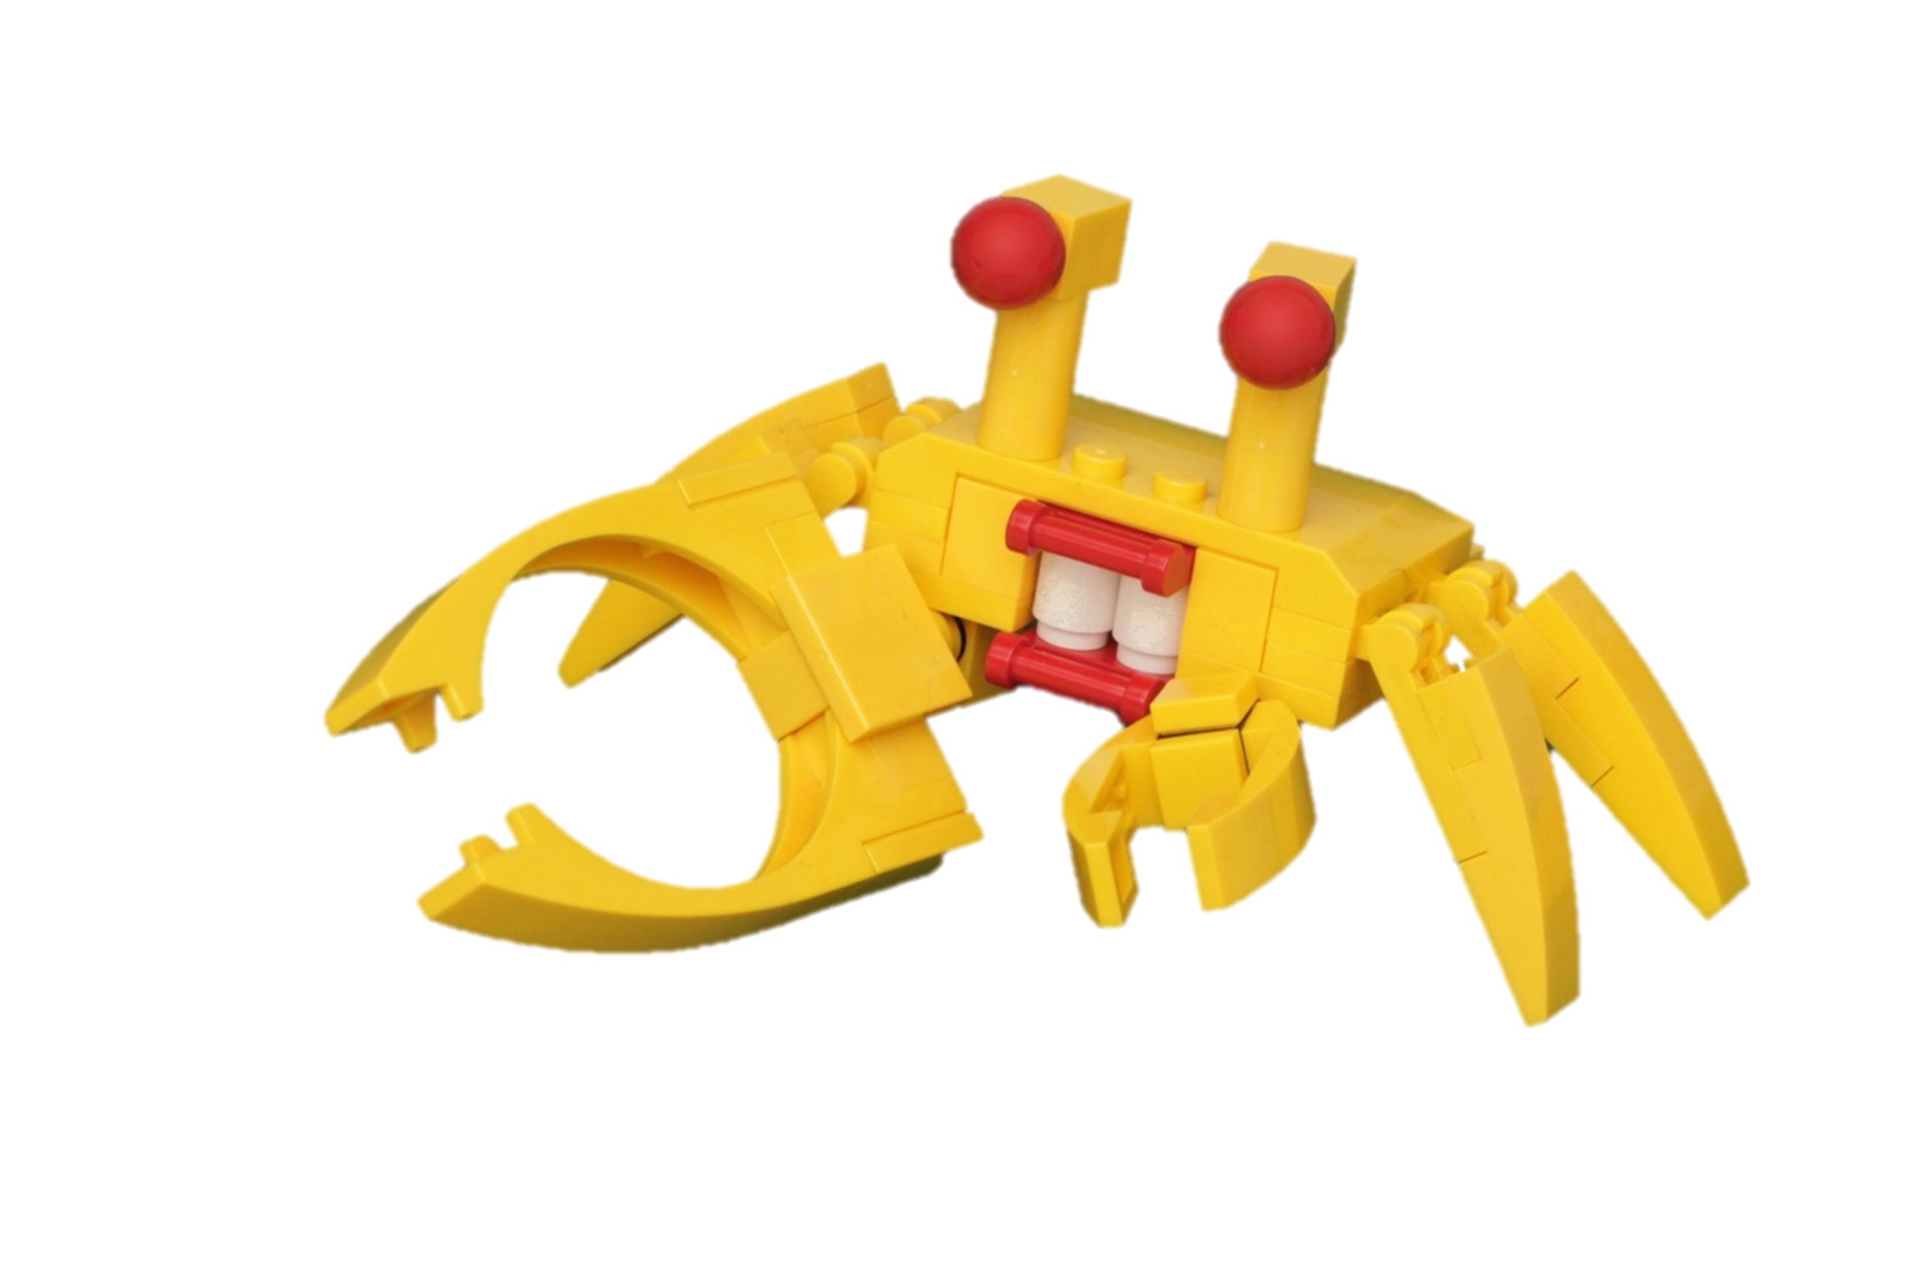
Meet Mr. Grabby
+
=
https://www.flickr.com/photos/pasukaru76/8278458818/
https://www.flickr.com/photos/fallentomato/5656700432/

Slide 16
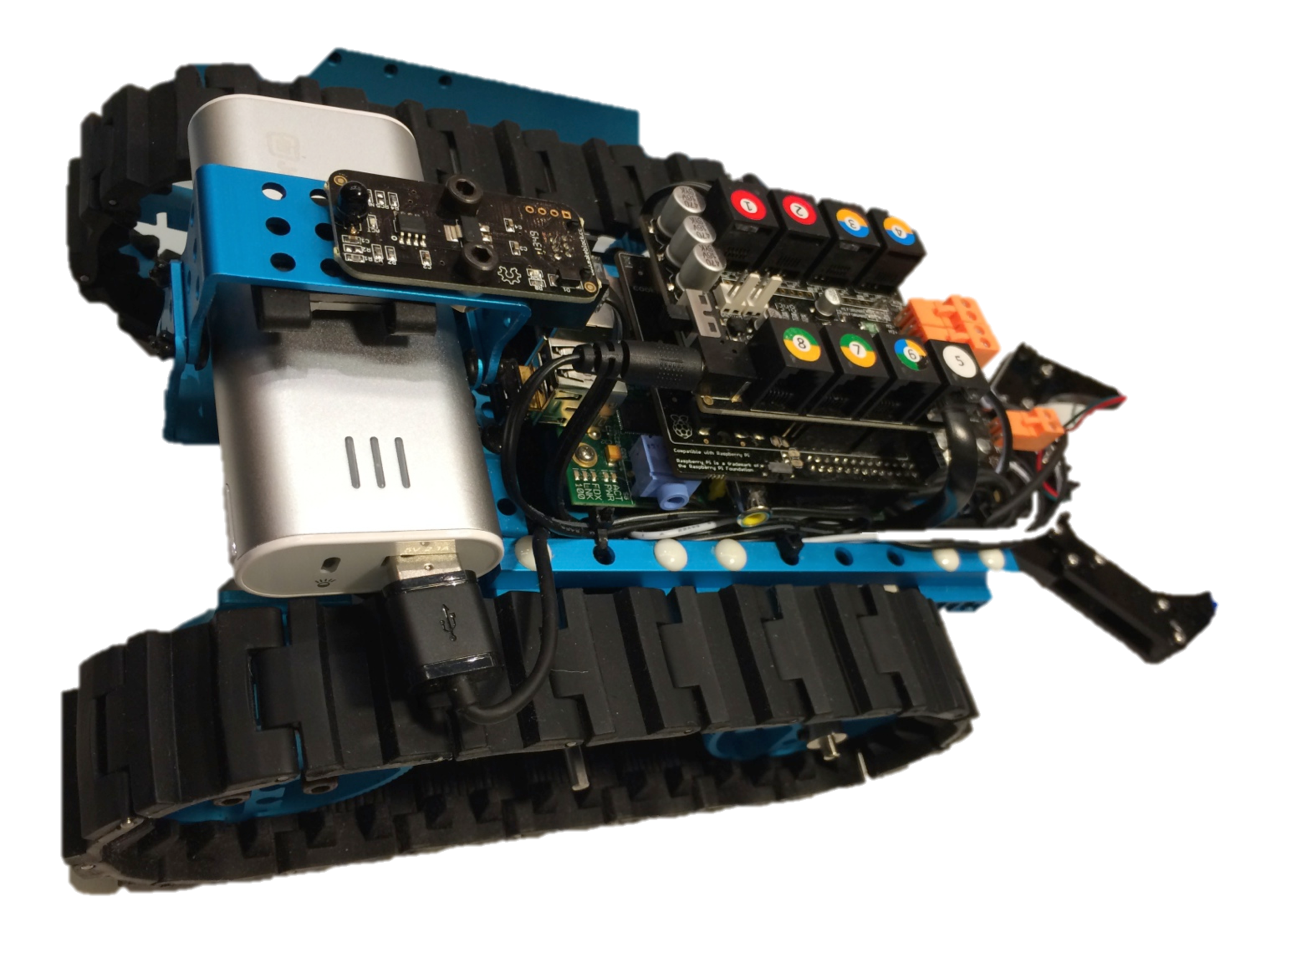
Meet Mr. Grabby

Slide 17
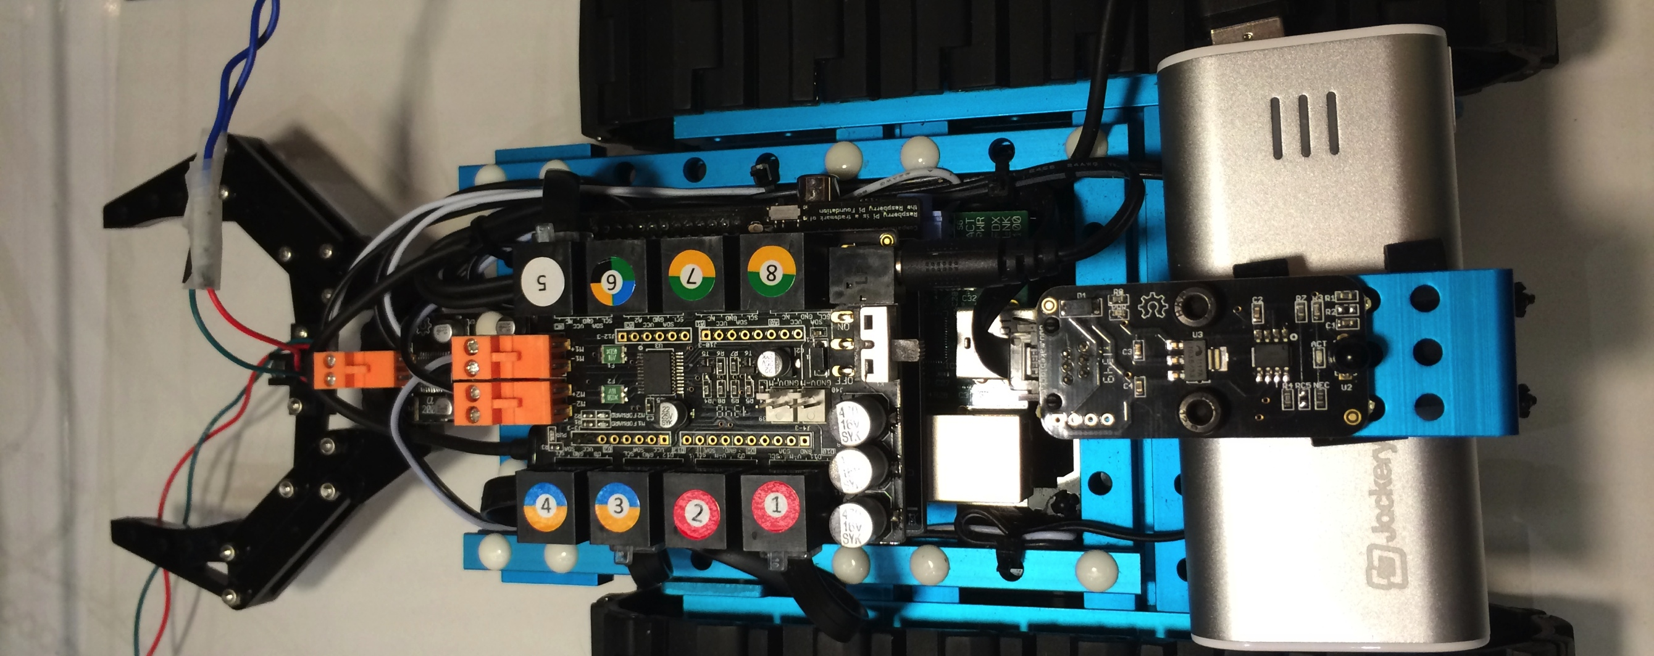
Mr. Grabby's Back
Controller
Grabber

Slide 18
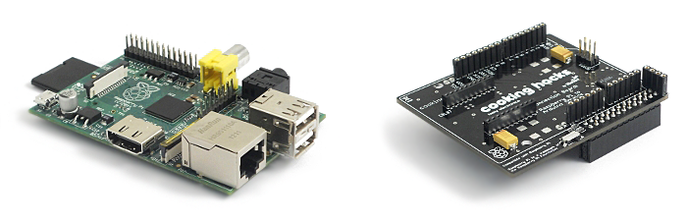
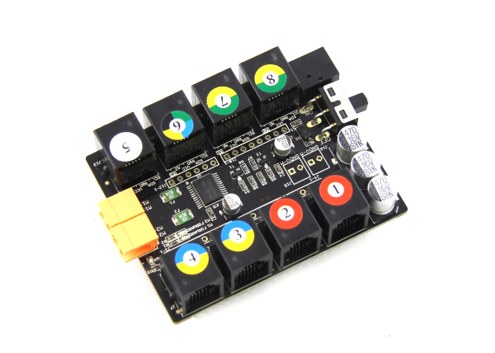
Controller
Raspberry Pi
Cooking Hacks Shield
MakeBlocks ME Base Shield

Slide 19
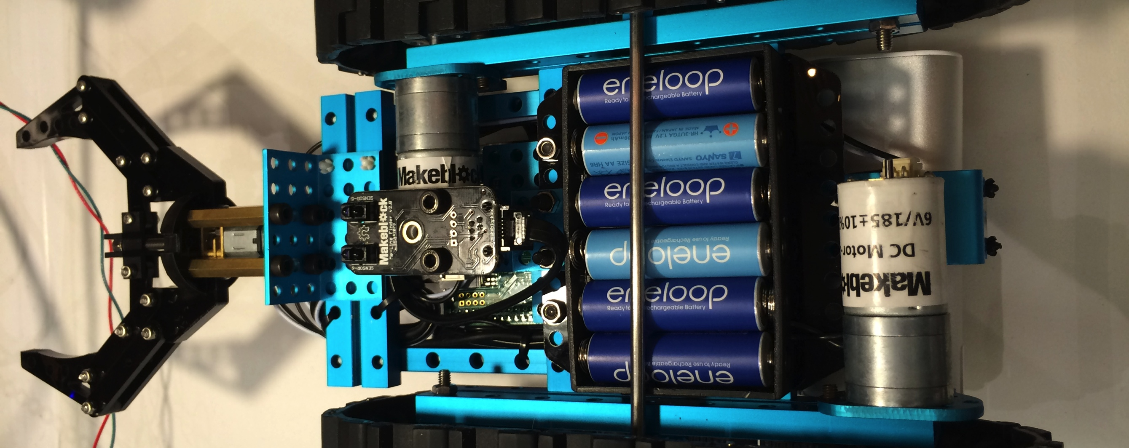
Mr. Grabby's Belly
Batteries
DC Motors
Line Follower

Slide 20
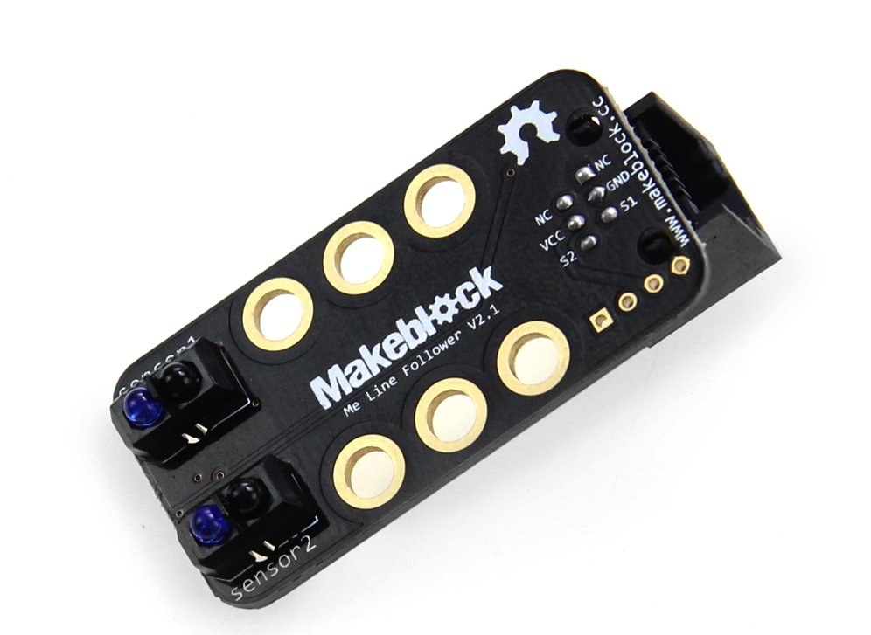
How Line Followers Work
Infrared LED
Bounced light off the ground
Infrared Luminosity Sensor
Detects reflected light

Slide 21
Getting GPIO
gpio = GpioFactory.getInstance();
lineFollowA = gpio.provisionDigitalInputPin( RaspiPin.GPIO_13, "LineFollowA");
lineFollowB = gpio.provisionDigitalInputPin( RaspiPin.GPIO_14, "LineFollowA");
startGPIO(); boolean leftSensor = lineFollowA.getState().isHigh();
boolean rightSensor = lineFollowB.getState().isHigh();

Slide 22
Line Following Algorithm
if (leftSensor && rightSensor) { //we are lost
doDrive(lineLocation);
} else if (!leftSensor && !rightSensor) { //on the line
lineLocation = Drive.forward; doDrive(Drive.forward);
} else if (!leftSensor && rightSensor) { //off the right
lineLocation = Drive.left; doDrive(Drive.forward);
} else if (leftSensor && !rightSensor) { //off the left
lineLocation = Drive.right; doDrive(Drive.forward);
}

Slide 23
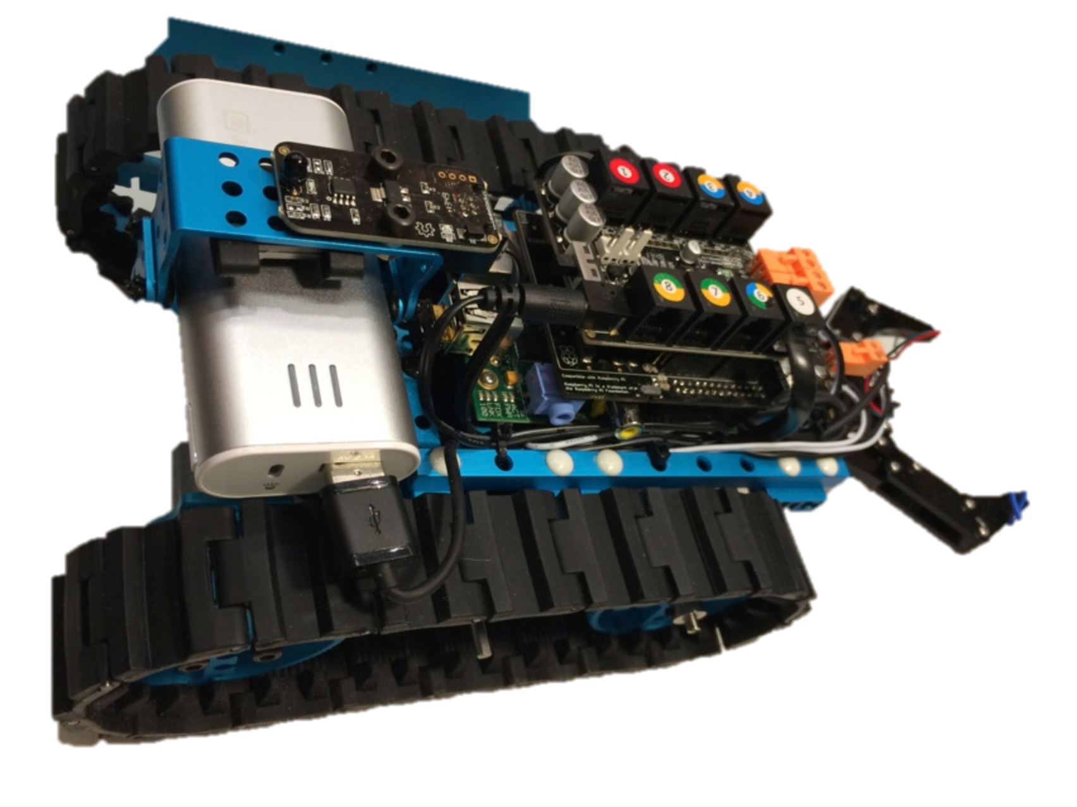
Make your own Mr. Grabby
MakeBlock Advanced Robotics Kit
MakeBlock ME Base Shield
Cooking Hacks Shield
USB Battery (1A)
Code here:
https://github.com/steveonjava/LineFollower

Slide 24

IoT Magic

Slide 25
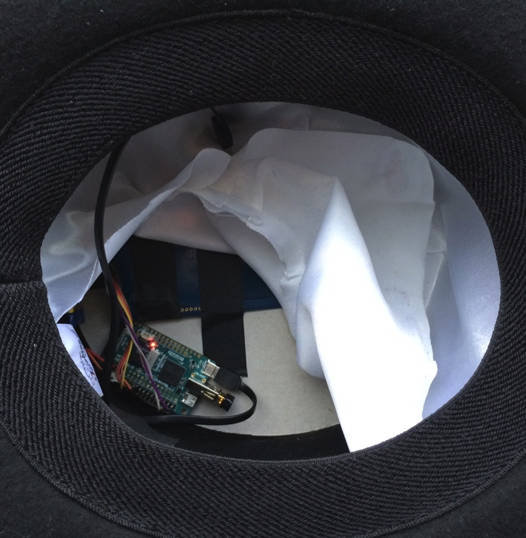
Wearable Raspberry Pi
IoT Magic Hat
ODROID-W
Raspberry Pi clone
NFC/RFID Sensor
Adafruit PN532 chipset
RFID Playing Cards
Mifare Ultralight tags embedded

Slide 26
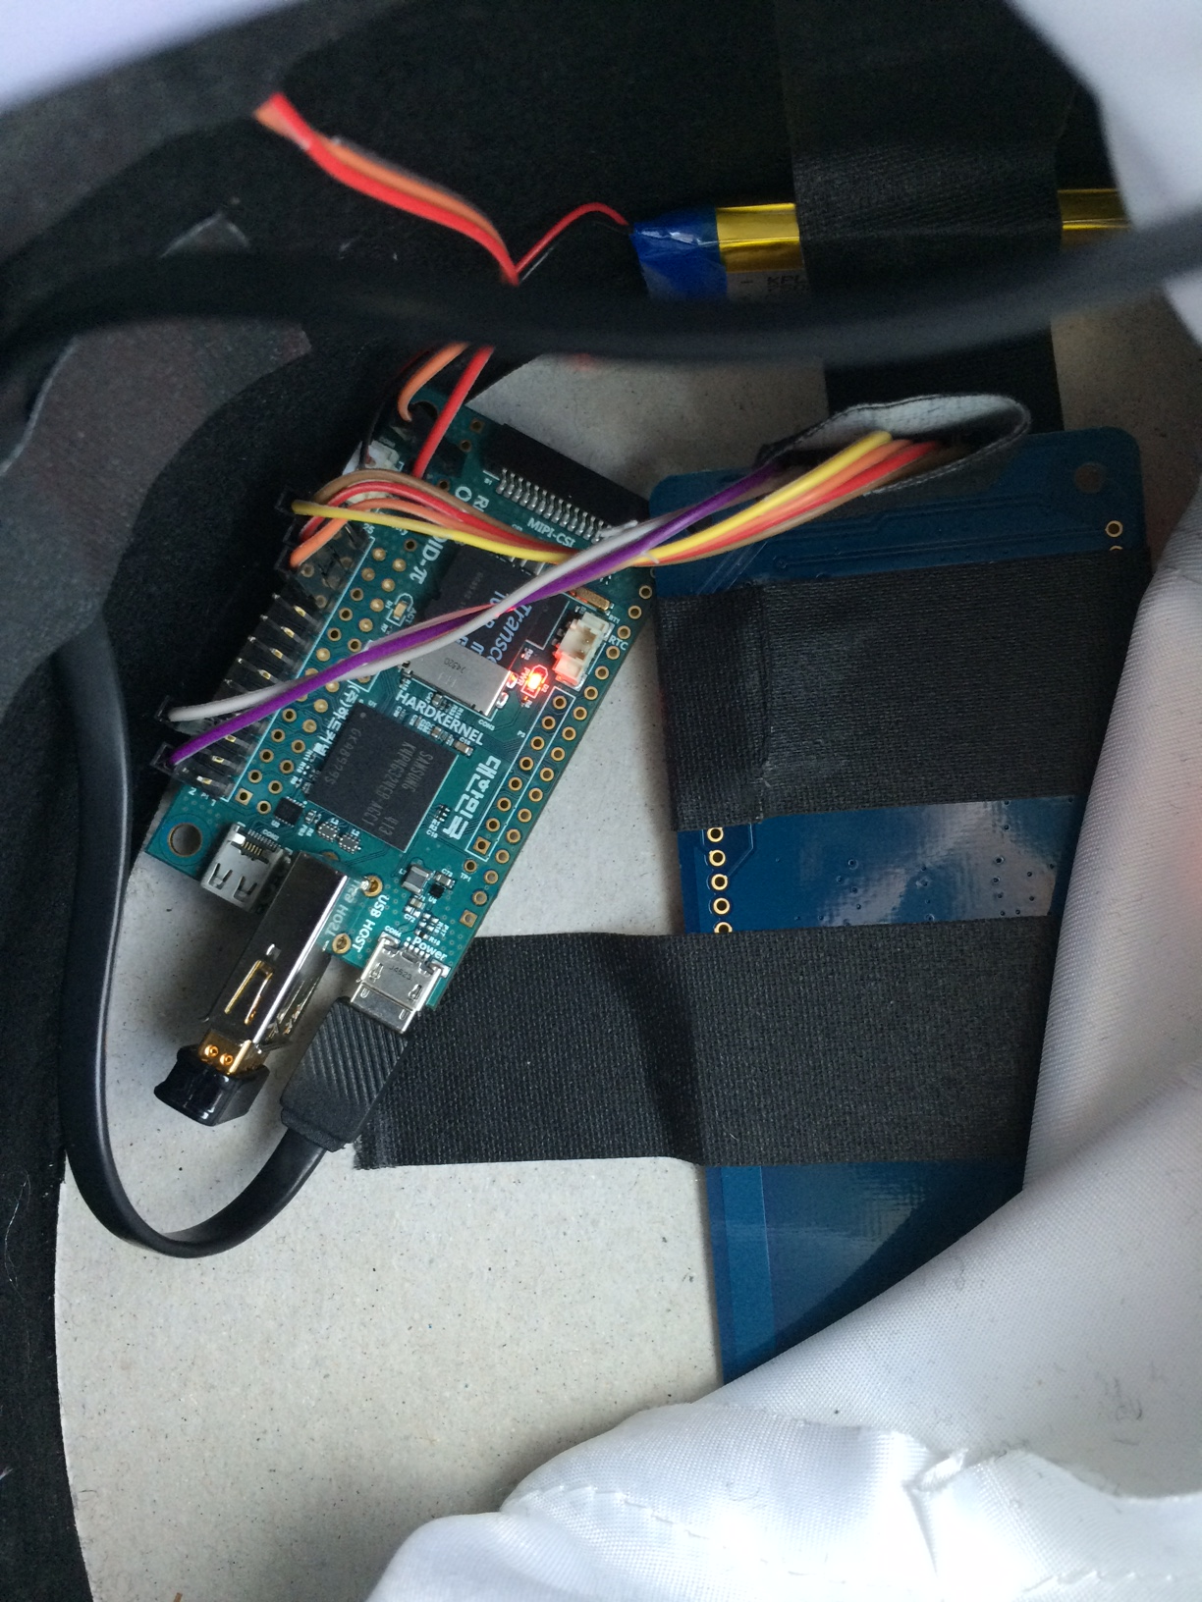

Slide 27
RFID/NFC Reader Configuration
Pi configuration
I2C, SPI, or UART
NFC configuration
libnfc to interface with the NFC reader.
pcscd to expose rfid readers to Java SE
idfnfc to bridge libnfc to idfnfc
Java hacking
smartio API that is already a part of the JRE.

Slide 28
Getting a Card Terminal
TerminalFactory factory = TerminalFactory.getDefault();
CardTerminals terminals = factory.terminals();
List<CardTerminal> list = terminals.list();
CardTerminal cardTerminal = list.get(0);

Slide 29
Waiting for a Card
while (true) {
cardTerminal.waitForCardPresent(0);
handleCard(cardTerminal);
cardTerminal.waitForCardAbsent(0);
}

Slide 30
Read Data
card = cardTerminal.connect("*");
CardChannel channel = card.getBasicChannel();
CommandAPDU command = new CommandAPDU(getAddress);
ResponseAPDU response = channel.transmit(command);
byte[] uidBytes = response.getData();

Slide 31
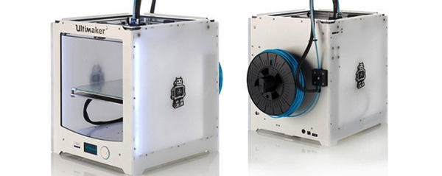
Ultimaker 2

Slide 32
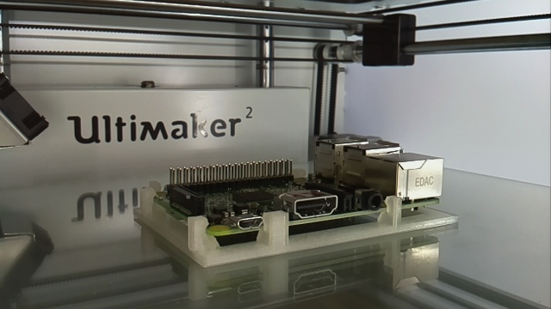

Slide 33
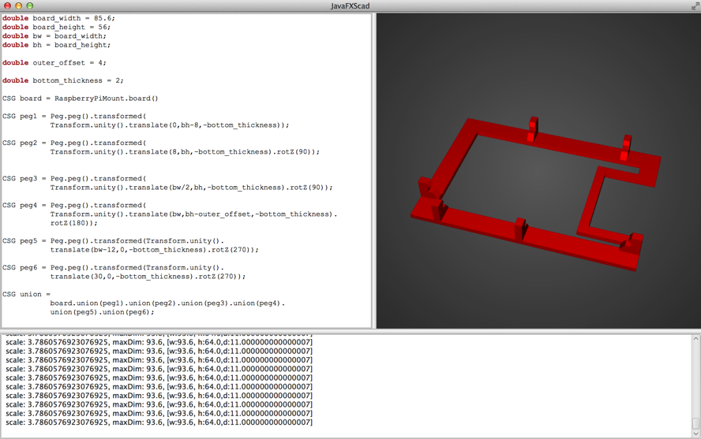
Java Constructive Geometry (JCSG / JFXScad)
Create geometries from pure Java code
Visualize with a JavaFX user interface
Generate STL files for 3D printing
Project sites:
https://github.com/miho/JCSG
https://github.com/miho/JFXScad

Slide 34
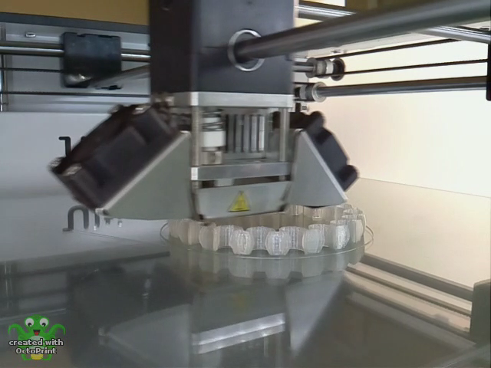

Slide 35
New Book Announcement
Raspberry Pi with Java

Slide 36

NightHacking Tour
Stephen Chin
tweet: @steveonjava
blog: http://steveonjava.com
Real Geeks
Live Hacking
nighthacking.com

